Slide 1
COMP7503 Multimedia Technology
Programming Assignment 1
2026.10.22

Slide 2
Roadmap
Project Overview
Environment Setup
Docker Basics
Project-specific Docker Configuration

Slide 3
1. Project Overview

Slide 4
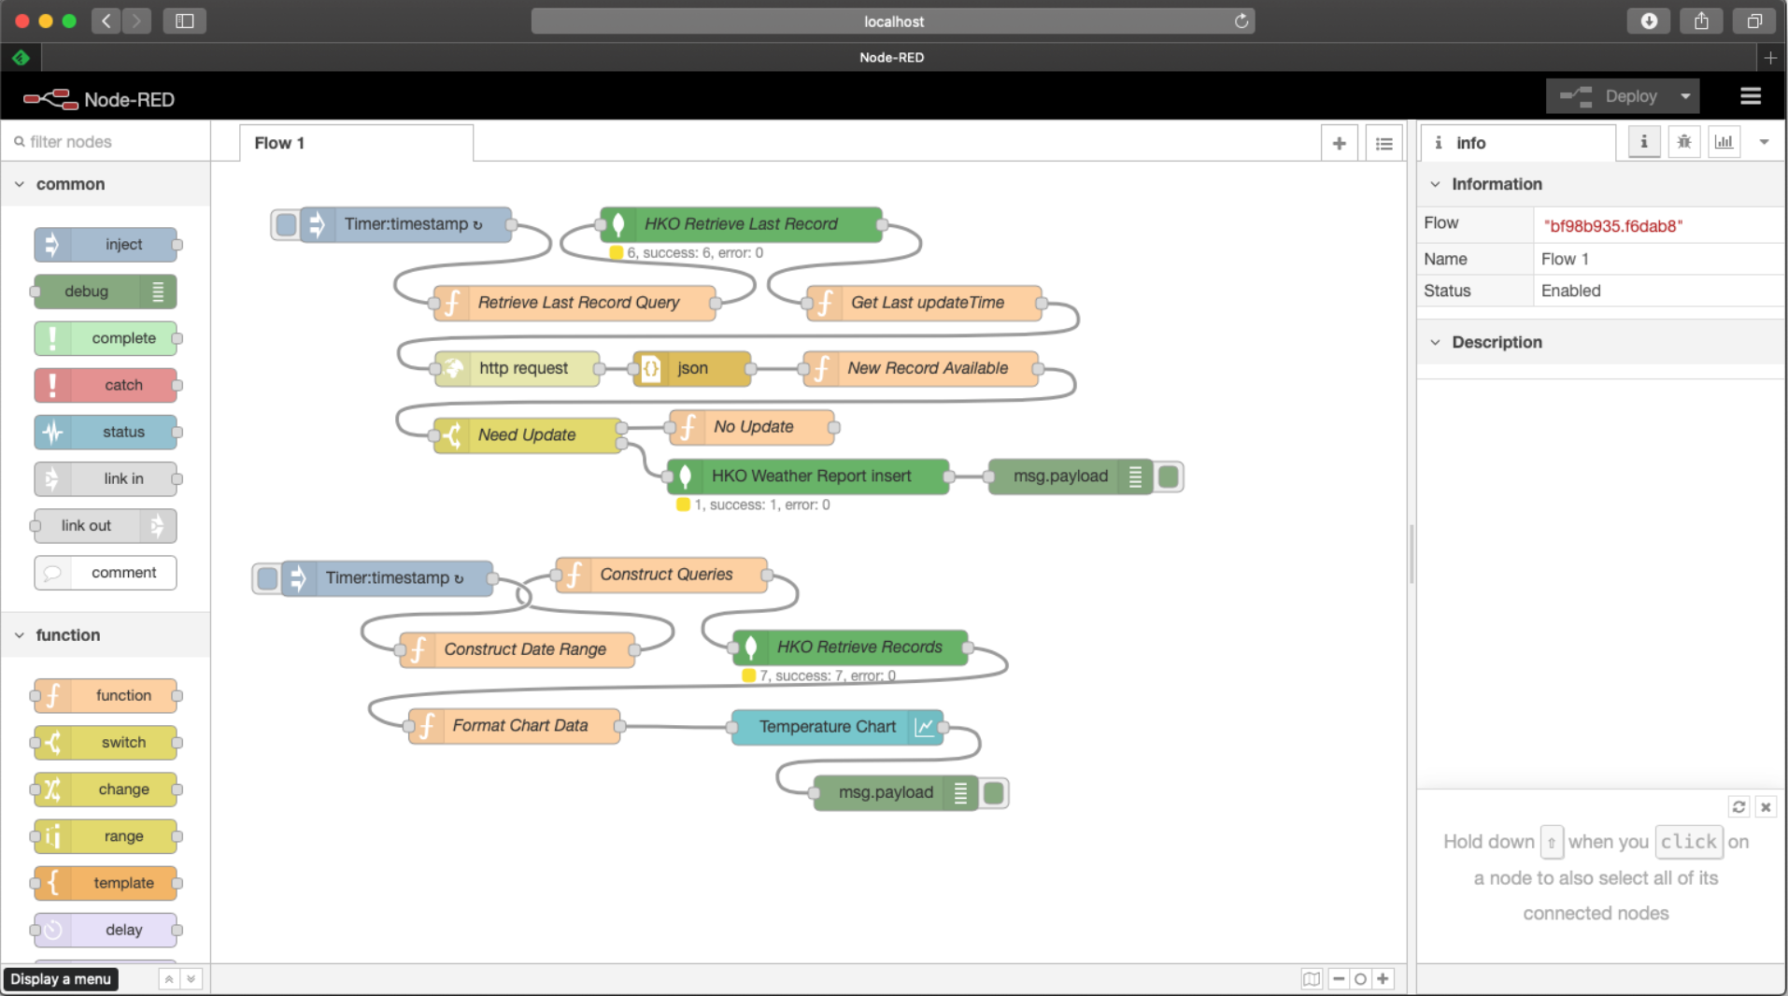
Project Overview
Notes:
Example program.
Fetch temperature data from HK Observatory
Plot historical temperature of various locations in HK. for

Slide 5
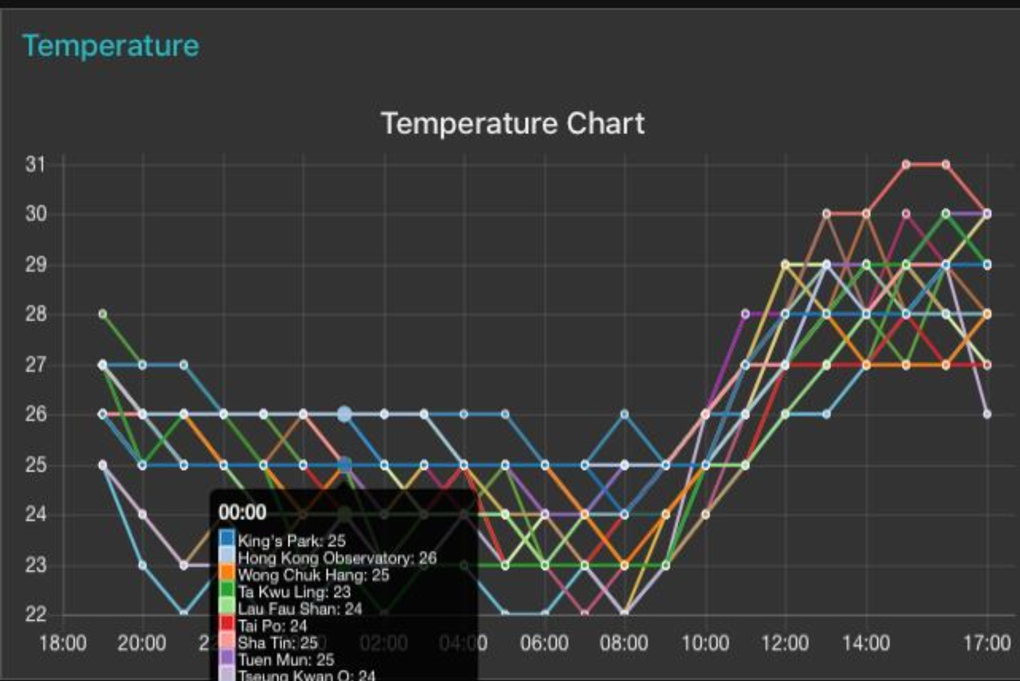
Project Overview
Notes:
historical temperature chart

Slide 6
2. Environment Setup

Slide 7
Environment Setup
Linux/MacOS: √
Windows: ×
  WSL
  Remote Linux Server
  Virtual Machine
  Dual Boot

Slide 8
3. Docker Basics

Slide 9
Docker for Linux: Setting Up
❖
Introduction
This tutorial is designed to help you to leverage Docker, a powerful platform for developing, shipping, and running applications. Docker simplifies the management of application processes in containers, which are isolated from each other and the host system.
Before diving into the setup of MongoDB and Node-RED, let's cover the basics of a Docker container.
This guidance is applicable only to Ubuntu and macOS; adjustments may be necessary for Windows. Additionally, if using a virtual machine for MongoDB, the CPU may need to support hardware virtualization.
Notes:
A container is a lightweight, stand-alone, executable package that includes everything needed to run a piece of software, including the code, runtime, libraries, and system settings.

Slide 10
Docker Basics
Open-source container platform
  Applications + Dependencies -> portable images
Images: read-only template containing dependencies to run an application
Containers: runnable images’ instances
  Isolated from one another
  shares host’s kernel
Standardized SW delivery
  Code behaves identically across laptops/CI pipelines/production clouds
Notes:
CI pipeline: continuous integration pipeline

Slide 11
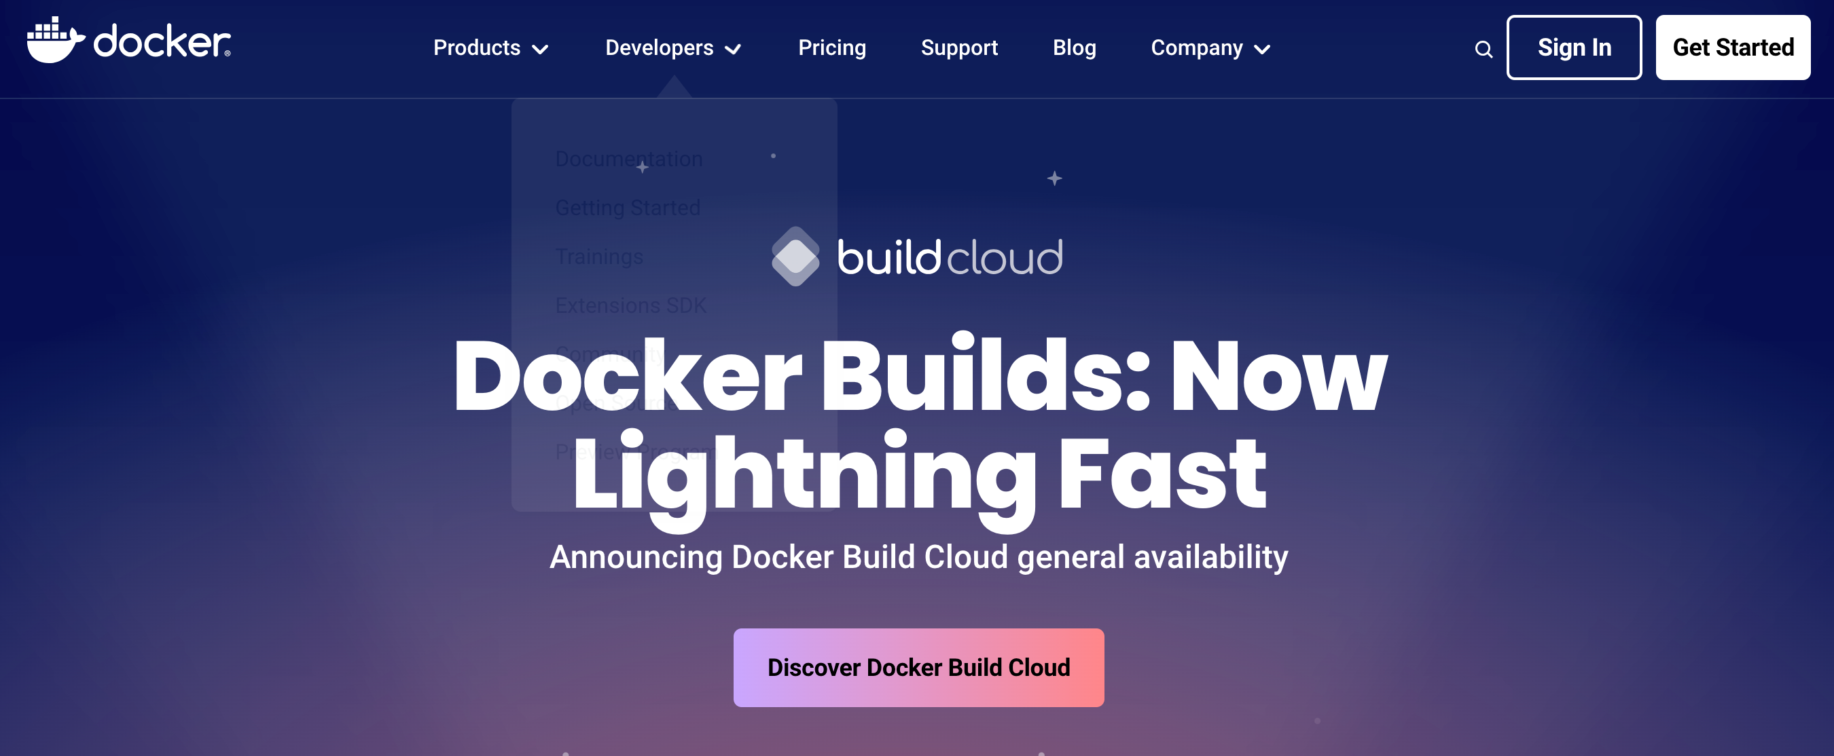
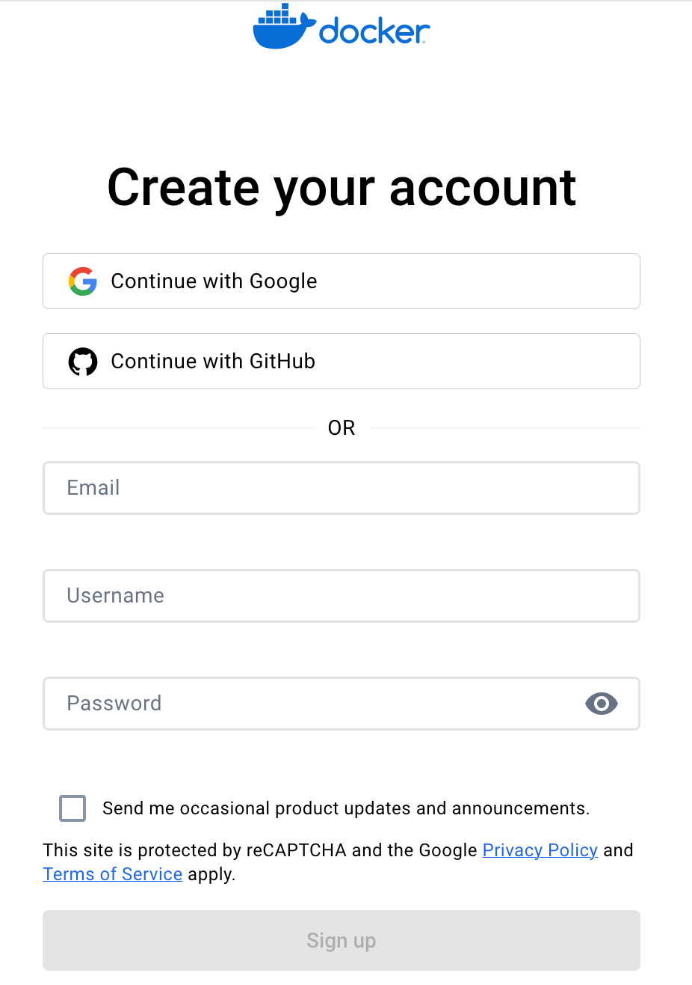
Create and activate a docker Account
❖
Docker home page at https://www.docker.com.
❖
On the Create an docker account page https://hub.docker.com/signup, enter your HKU email address (educators/ teaching staff: UID@hku.hk; students: UID@connect.hku.hk), password (a new password at your choice for login to docker) and account name (please put in your Portal UID unless it has been taken up by others), and then click Sign up.

Slide 12
Creating Your Docker Container
❖
Installation of Docker
Execute the following commands sequentially:
Download the Docker installation script:
2. Run the installation script:
bash
curl -fsSL https://test.docker.com -o test-docker.sh
bash
sudo sh test-docker.sh

Slide 13
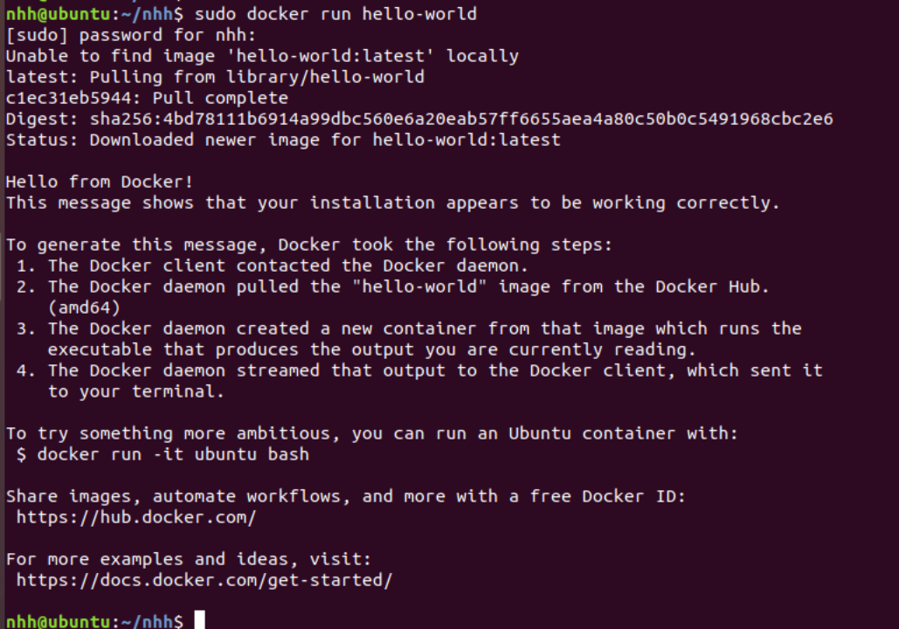
Creating Your Docker Container
❖
To test if Docker has been installed successfully, enter the command:
If you see a message similar to the one depicted below, Docker has been successfully installed.
sudo docker run hello-world

Slide 14
4. Project Specific Docker Configuration

Slide 15
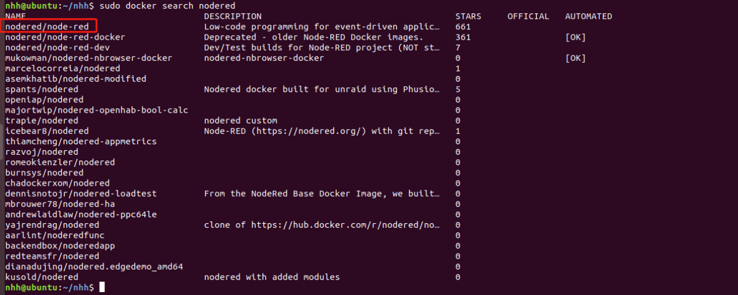
Install Node-RED Using Docker
❖
Searching for the Node-RED Image Version:
To find the version of the Node-RED image you want to install, enter the command:
sudo docker search nodered
From the results, we select nodered/node-red.

Slide 16
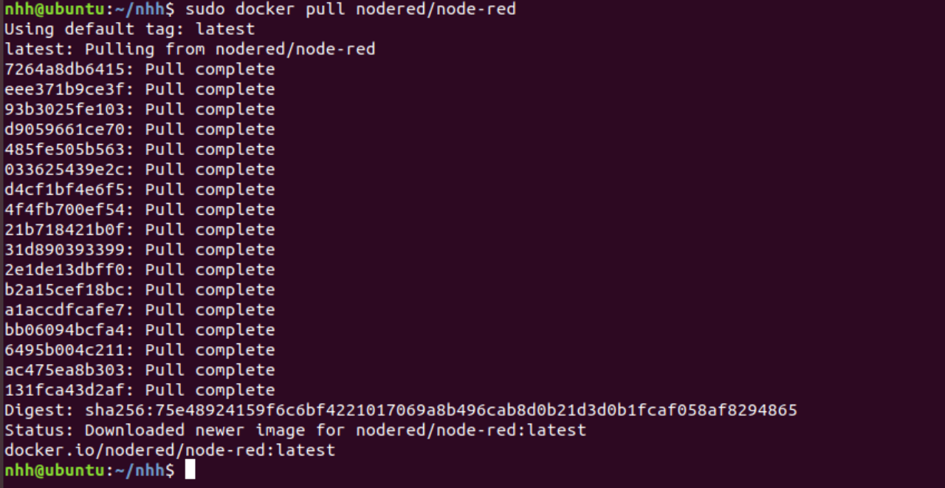
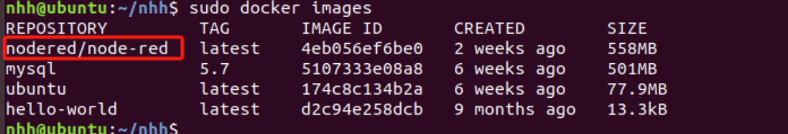
Install Node-RED Using Docker
❖
2. Pulling the Image
To pull the image, enter the command: sudo docker pull nodered/node-red
After executing sudo docker images, nodered/node-red has been successfully pulled.

Slide 17
Install Node-RED Using Docker
❖
3. Running the Node-RED Image as a Container
Create a Directory: Execute sudo mkdir /opt/node_red
Assign Permissions: Execute sudo chmod 777 /opt/node_red
Run the Image: sudo docker run -itd -p 1880:1880 -v /opt/node_red:/data --name nodered nodered/node-red
-v /opt/node_red:/data mounts the host's /opt/node_red directory to /data in the container.
--name nodered sets the container's name to nodered. You can see the running container named nodered by executing sudo docker ps -a.
Notes:
sudo docker run -itd -p 1880:1880 -v /opt/node_red:/data --name nodered nodered/node-red

Slide 18
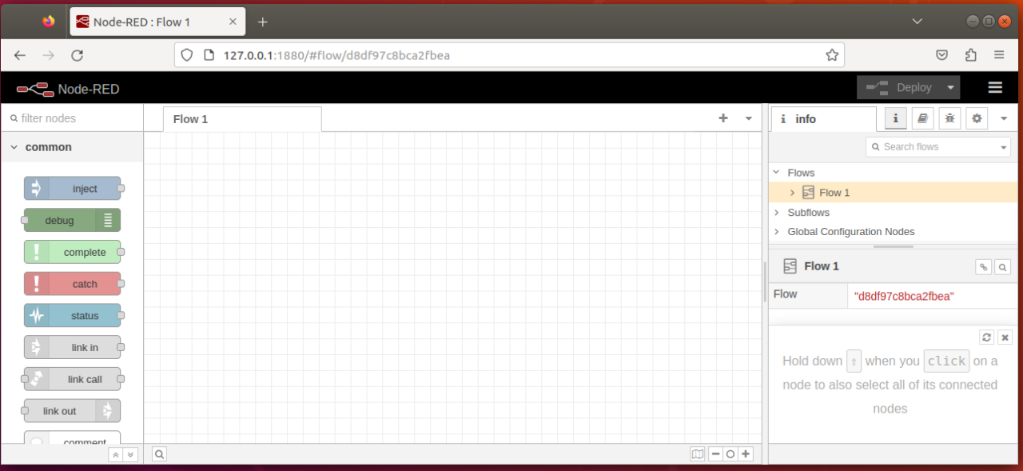
Install Node-RED Using Docker
Verifying the Container:
Open Google Chrome or any web browser and enter http://127.0.0.1:1880. If you see the Node-RED interface as expected, the container is running correctly.

Slide 19
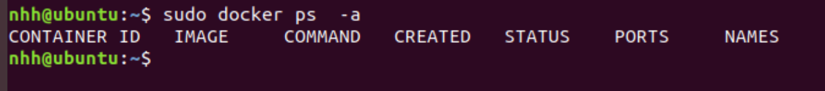
Install Node-RED Using Docker
4. Deleting the Container (Demonstration only. Don’t do so if you need to use it later)
❖
Get the Container ID: Enter sudo docker ps -a. Let's say the container ID is eaba53fa9c03.
Stop the Container: Execute sudo docker stop eaba53fa9c03. After this, if you run sudo docker ps -a, you should see the container's status as Exited.
Delete the Container: Execute sudo docker rm -f eaba53fa9c03. Afterward, running sudo docker ps -a will show that the container no longer exists.
Notes:
do we do this here now?

Slide 20
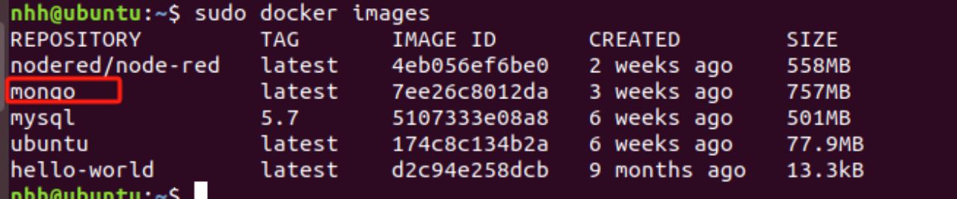
Install mongodb Using Docker
❖
1. Pulling the Image
To download the latest MongoDB image, enter the command: sudo docker pull mongo:latest
After executing sudo docker images, you will see that the MongoDB image has been successfully pulled.

Slide 21
Install mongodb Using Docker
❖
2. Running the MongoDB Image as a Container and Verification
Create a Directory: Execute sudo mkdir /opt/mongodb.
Assign Permissions: Execute sudo chmod 777 /opt/mongodb.
Run the Image: sudo docker run -itd -p 27017:27017 -v /opt/mongodb:/data/db --name Mymongo mongo:latest
-v /opt/mongodb:/data/db mounts the host's /opt/mongodb directory to /data/db in the container.
--name Mymongo sets the container's name to Mymongo. You can see the running container named Mymongo by executing sudo docker ps -a.

Slide 22
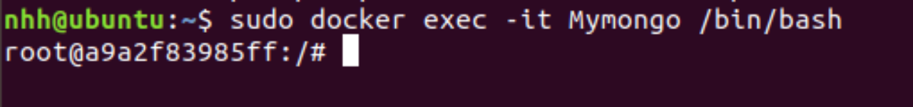
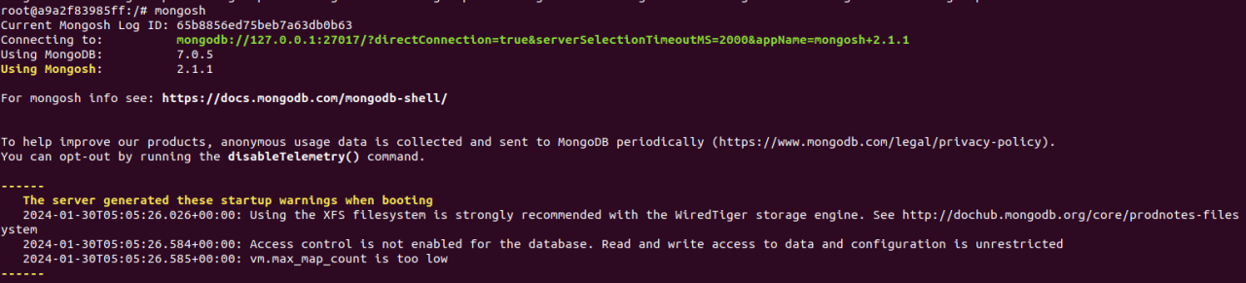
Install mongodb Using Docker
Entering the Container
To enter the container, use the command: sudo docker exec -it Mymongo /bin/bash
Then, start the MongoDB shell by entering mongosh.

Slide 23
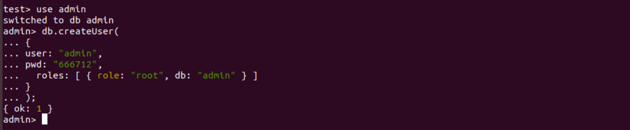
Install mongodb Using Docker
Create an admin user with the following commands:
          use admin
          db.createUser(
          {
          user: "admin",
          pwd: " 666712",
          roles: [ { role: "root", db: "admin" } ]
          }
          );

Slide 24
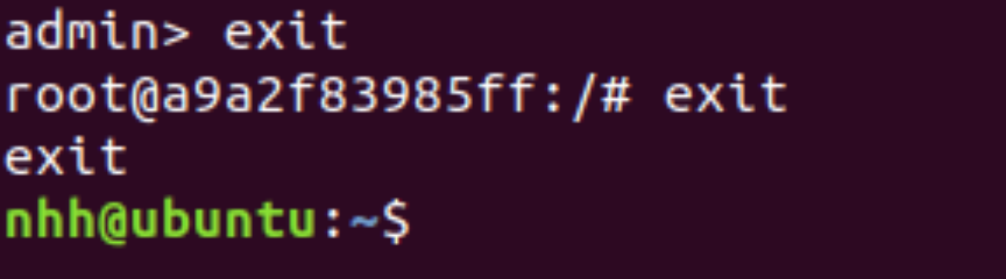
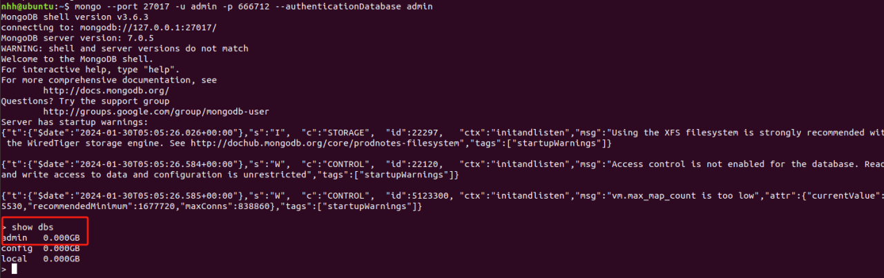
Install mongodb Using Docker
To exit the MongoDB shell, type exit, then type exit again to leave the container.
❖
To connect to MongoDB within the container, use: mongo --port 27017 -u admin -p 666712 --authenticationDatabase admin. After connecting, entering show dbs will display the databases, including the admin database you created.
❖
Notes:
docker exec -it Mymongo mongosh
docker exec -it Mymongo mongosh --port 27017 -u admin -p 666712 --authenticationDatabase admin (why?)

Slide 25
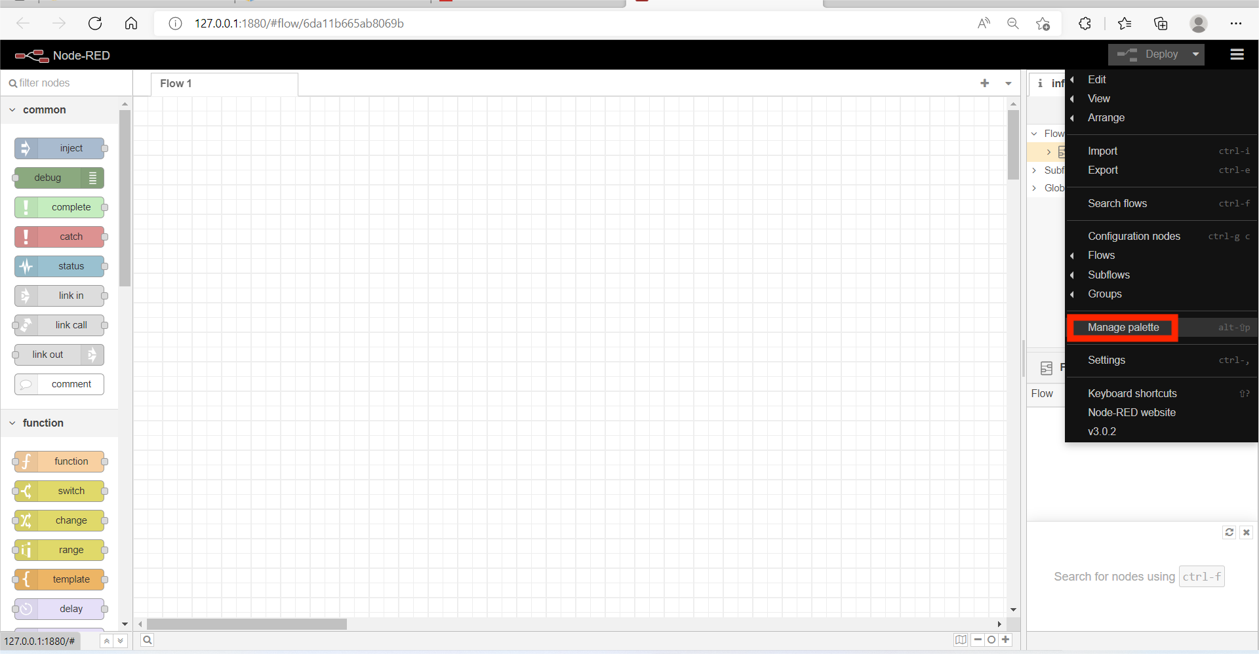
Installing MongoDB and Dashboard Modules in NodeRed
❖
Use a browser to access the URL: http://localhost:1880
Click the top right icon, select and click Manage Palette
❖
Notes:
if you have exited nodered: sudo docker run -itd -p 1880:1880 -v /opt/node_red:/data --name nodered nodered/node-red

Slide 26
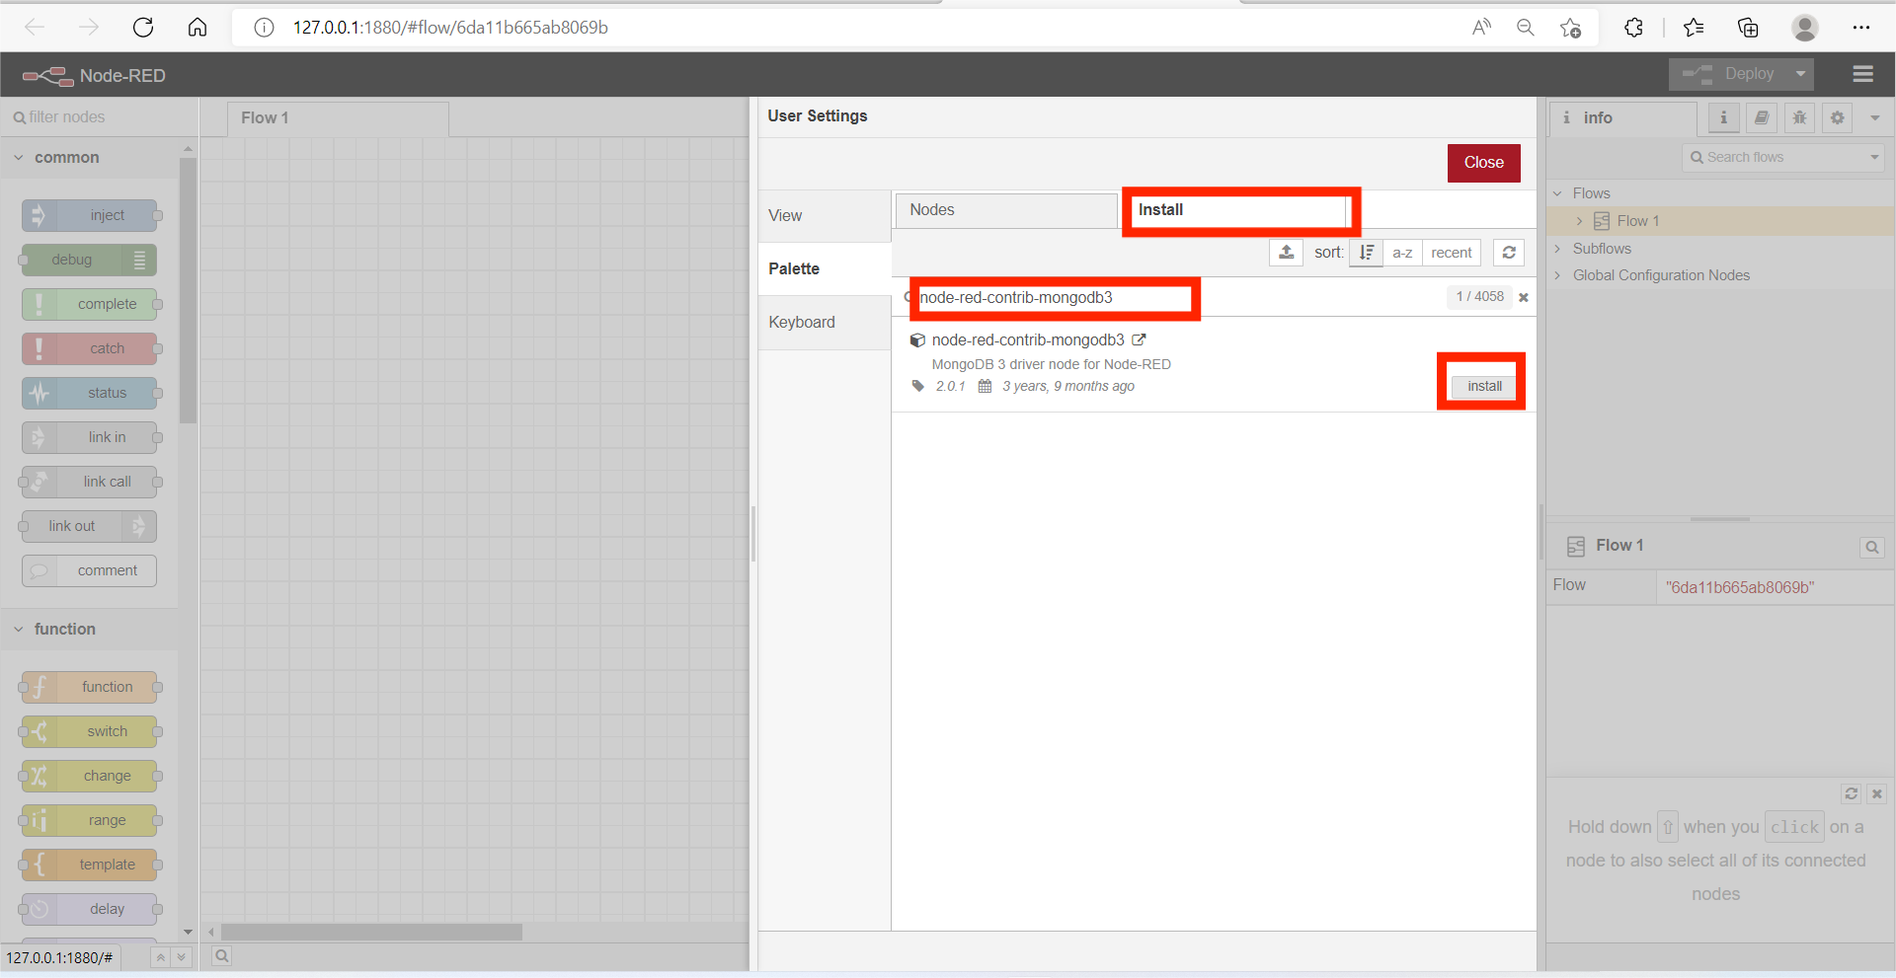
Installing MongoDB and Dashboard Modules in NodeRed
❖
Select the Install Tab, and input MongoDB in the search field.
Scroll down and locate the row with node-red-contrib-mongodb3, and click Install button, and click Install button again in the pop-up window.
❖
Notes:
Mac user: node-red-contrib-mongodb3 + node-red-dashboard

Slide 27
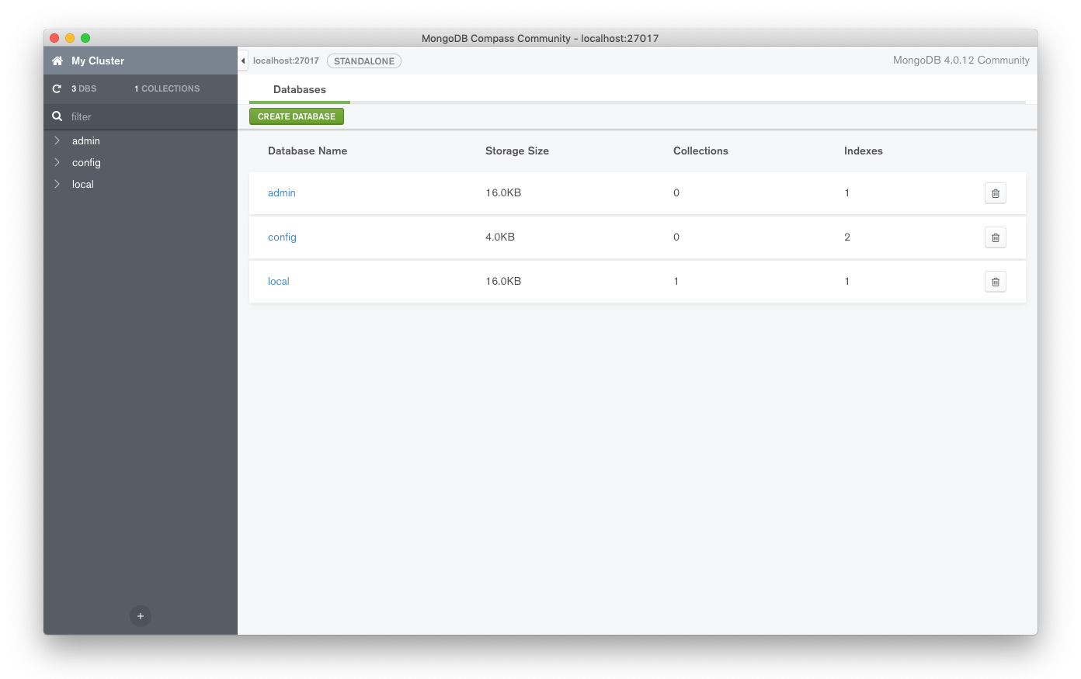
Accessing MongoDB
❖
Once connected, you should be able to browse your data stored in your MongoDB instance.
Notes:
This page shows MongoDB compass. if on mac: brew install --cask mongodb-compass.
go to mongodb compass, add connection localhost: 27017

Slide 28
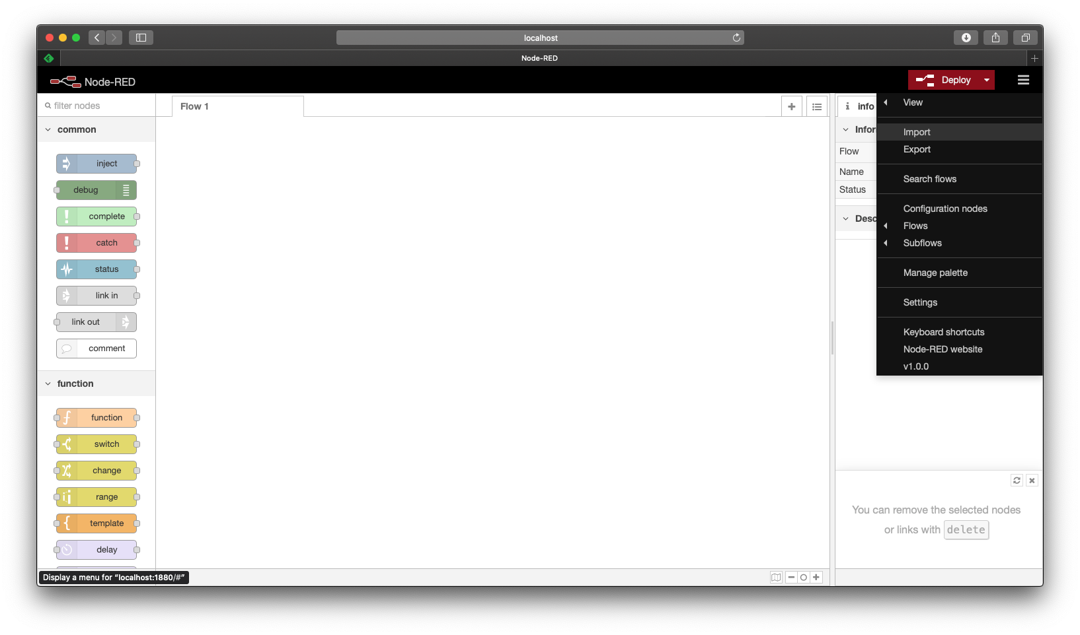
Node-Red Example Program
❖
Download the the HKO.Flow.txt file from moodle, and import it into your NodeRed environment:
1
2

Slide 29
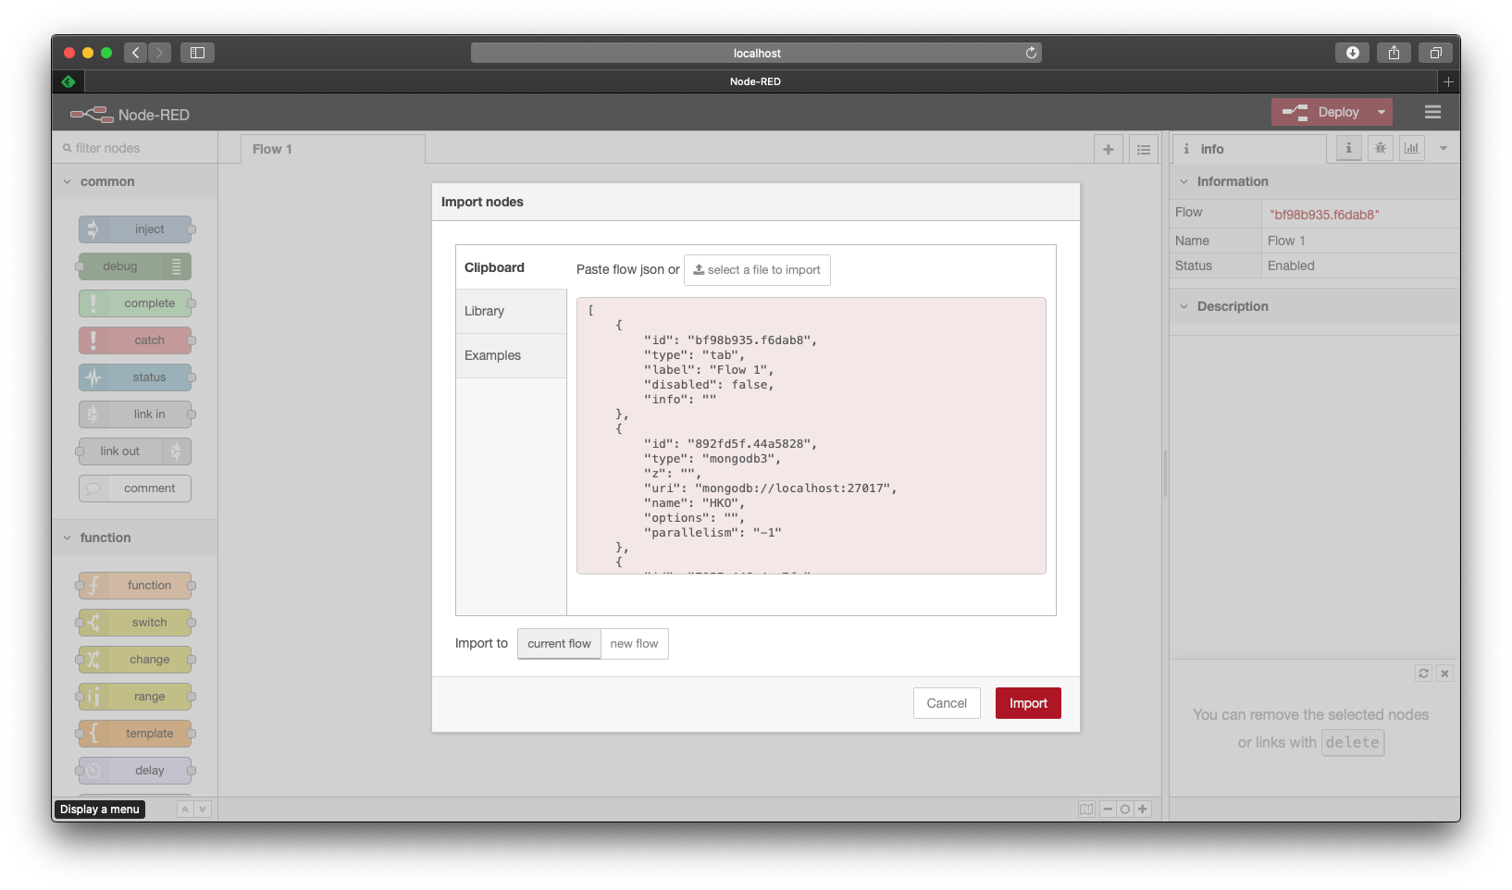
Node-Red Example Program
❖
Download the the HKO.Flow.json file from moodle, and import it into your NodeRed environment:
1
2

Slide 30
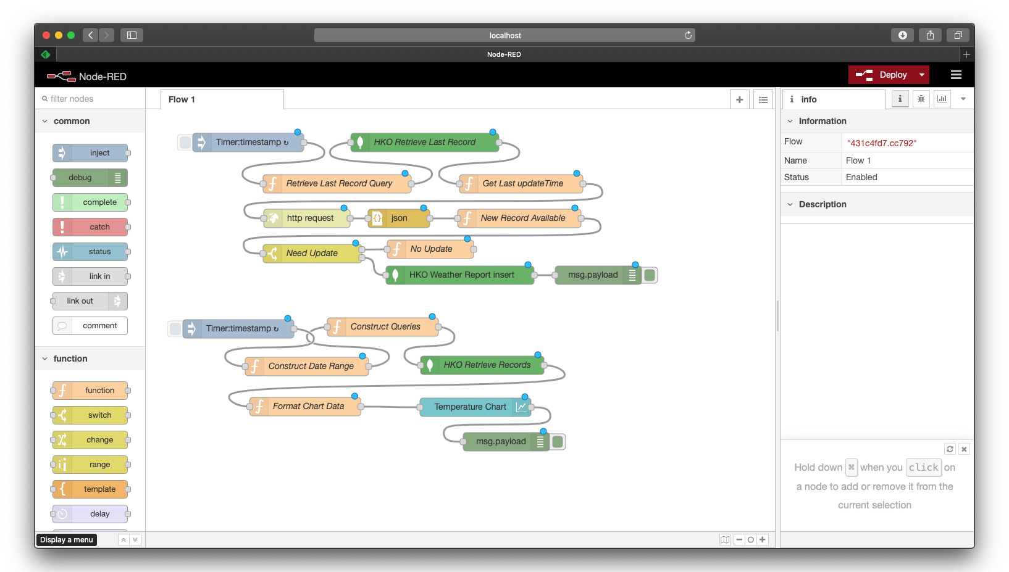
Node-Red Example Program
❖
After importing the flow, click Deploy button
Notes:
If you are using Mac:
go to HKO node, set server to: mongodb://host.docker.internal:27017

Slide 31
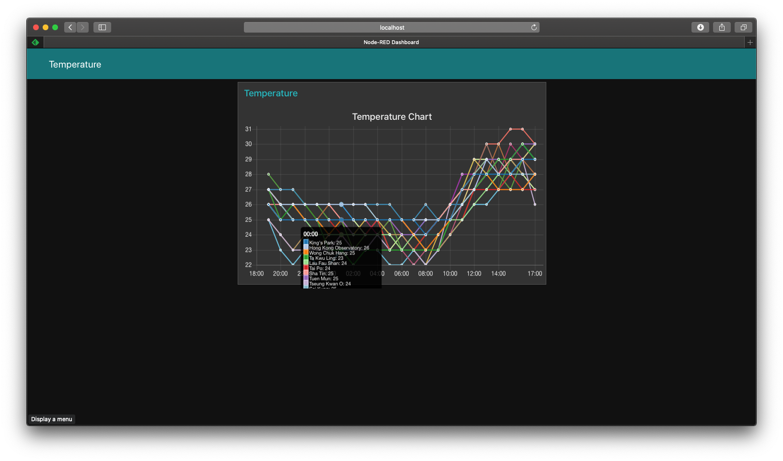
Node-Red Example Program
❖
After deployment, you can let the node-red instance to run for a couple of hours, and then launch another browser window and open the URL: http://localhost:1880/ui

Slide 32

Node-Red Example Program
❖
You should see a chart, which plots the historical temperature of various Hong Kong locations up to the last 24 hours

Slide 33
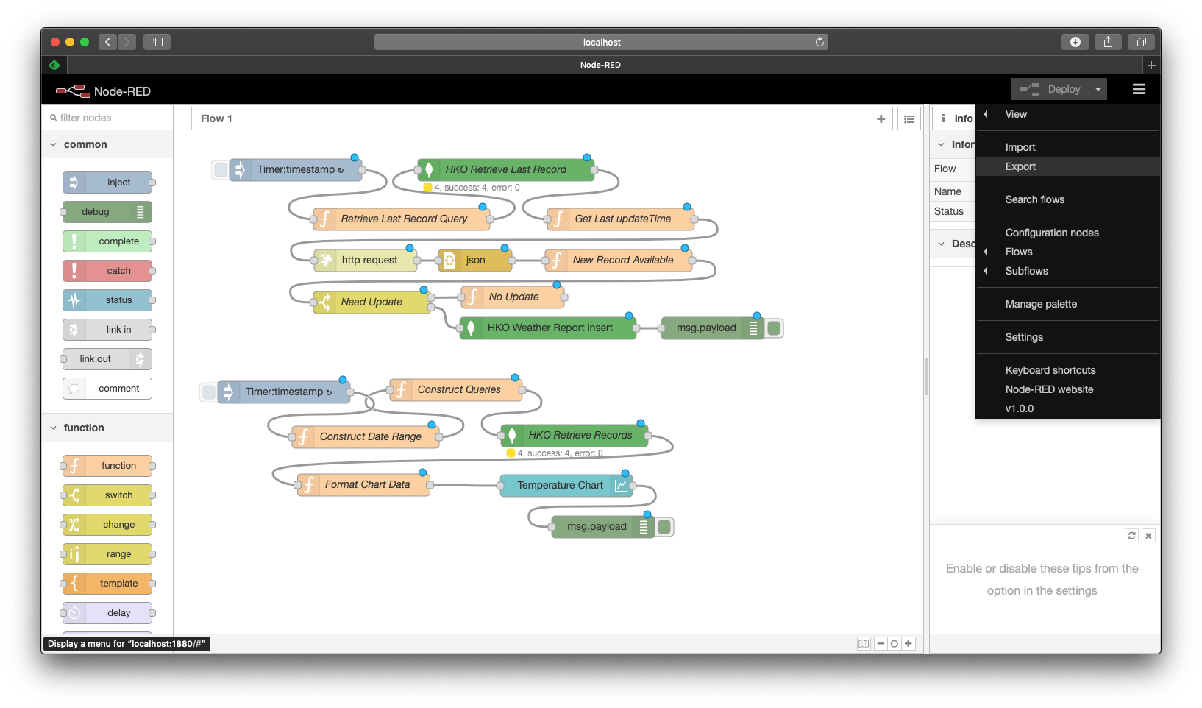
Exporting Node-Red Flow for Submission
Click the top right icon, and select Export
1
2

Slide 34
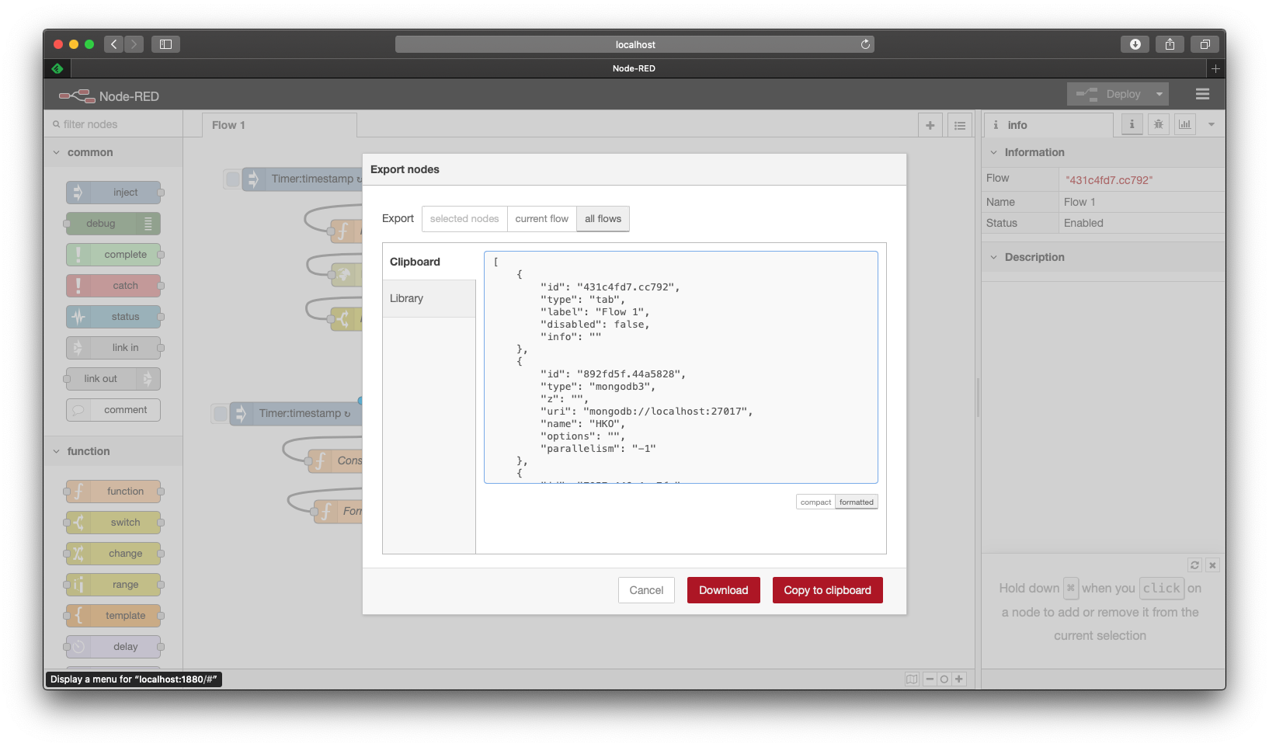
Exporting Node-Red Flow for Submission
Select all flows, formatted, and click Download button
1
2
3

Slide 35
Assignment Submission
❖
Exported flow file: After completion of your assignment, you should export your flows in your node-red environment for submission in Moodle.
Docker ID from docker hub or docker description file
Project report
❖
You should provide clear procedure to reproduce your development environment, so that your tutor can access your docker instance for grading purpose.

Slide 36
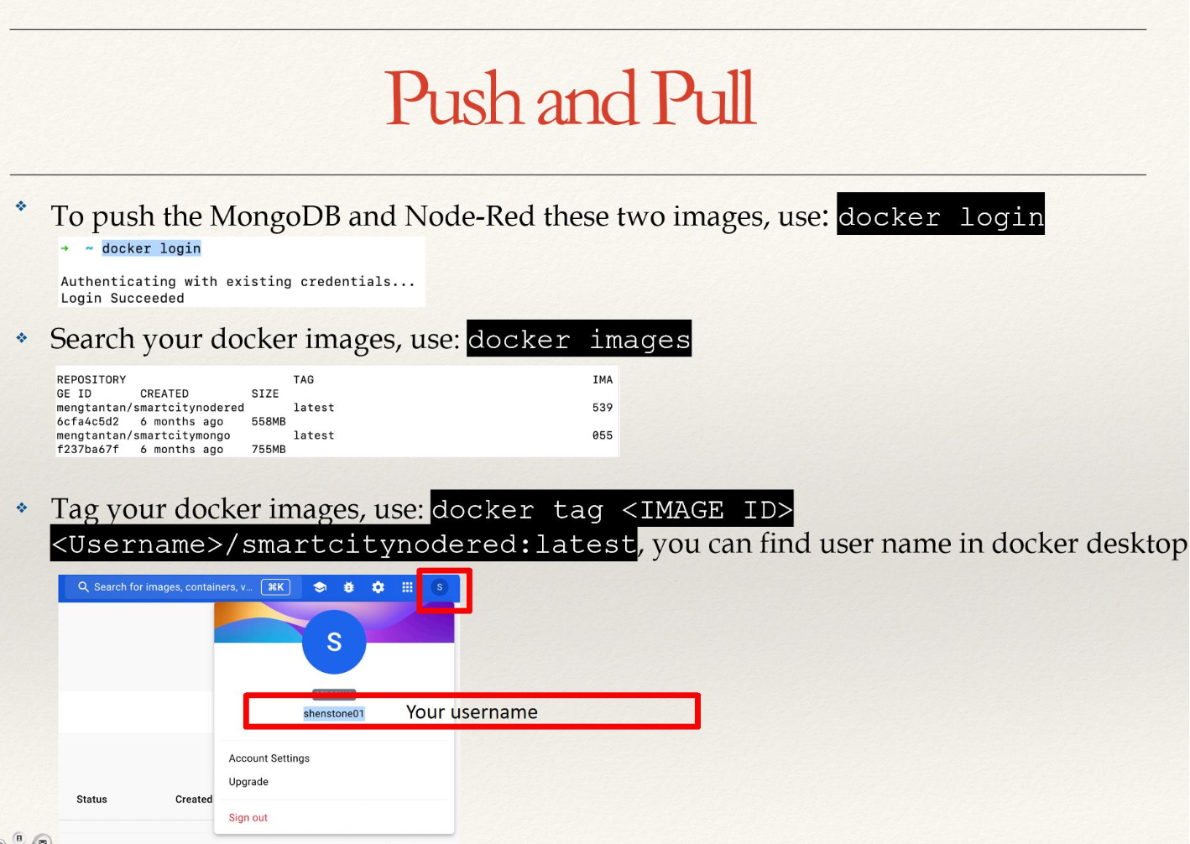
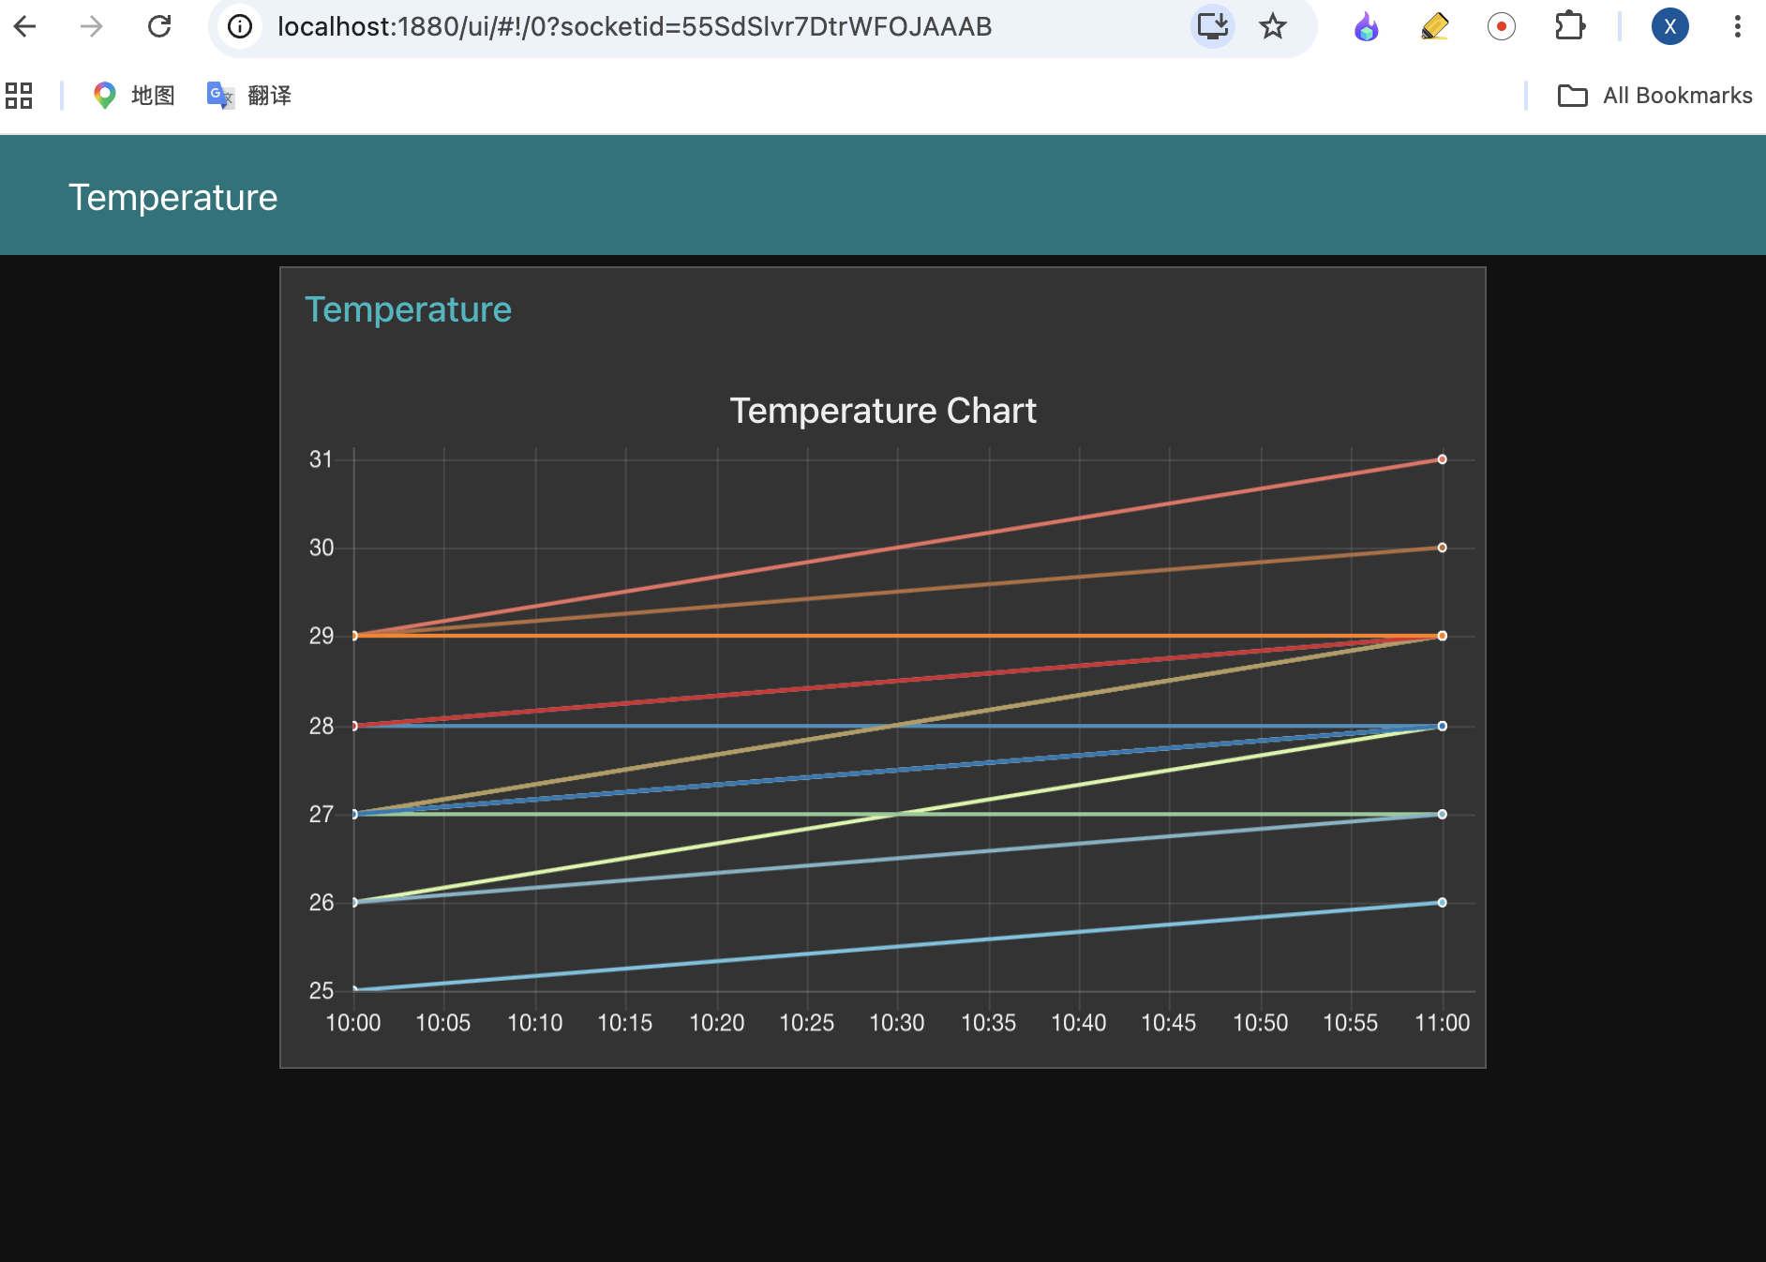
Assignment Submission
First, login to docker: docker login
Search your docker images: docker image
Tag your docker images:
docker tag <Image ID> <username>/smartcitymongo:latest
Example:
docker tag 6cfa4c5d2 Shenstone01/smartcitynodered
docker tag b80341870 Shenstone01/smartcitymongo

Slide 37
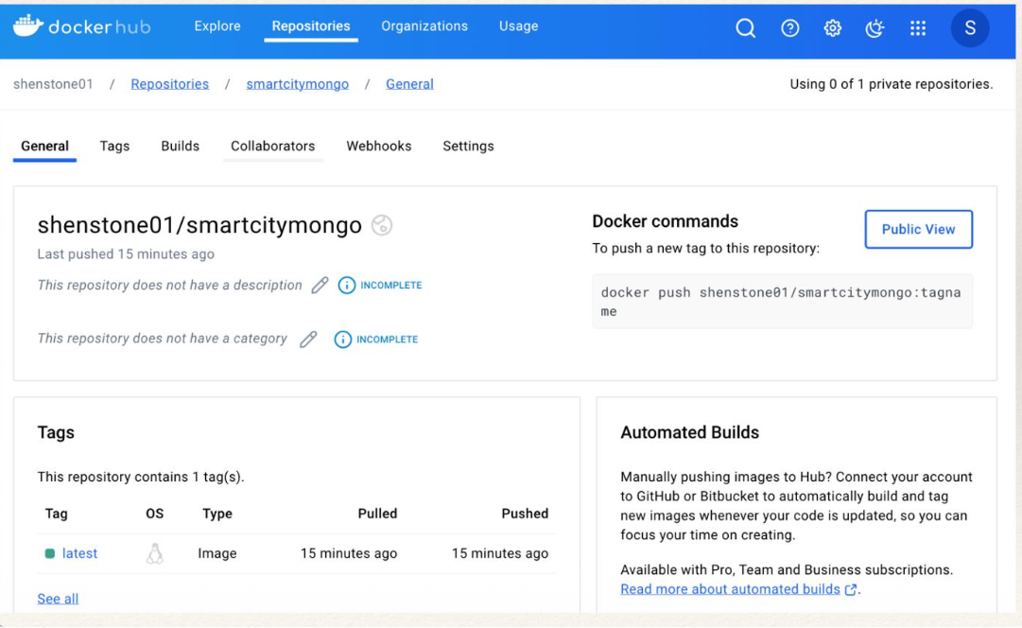
Assignment Submission
You can push your image by: docker push <your-username>/smartcitymongo:latest
You can download (pull) the example: docker pull shenstone01/smartcitymongo:latest
For example: docker push shenstone01/smartcitymongo:latest

Slide 38
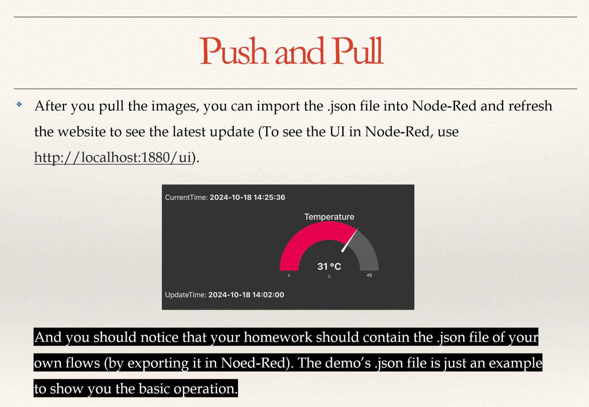
Assignment Submission

Slide 39
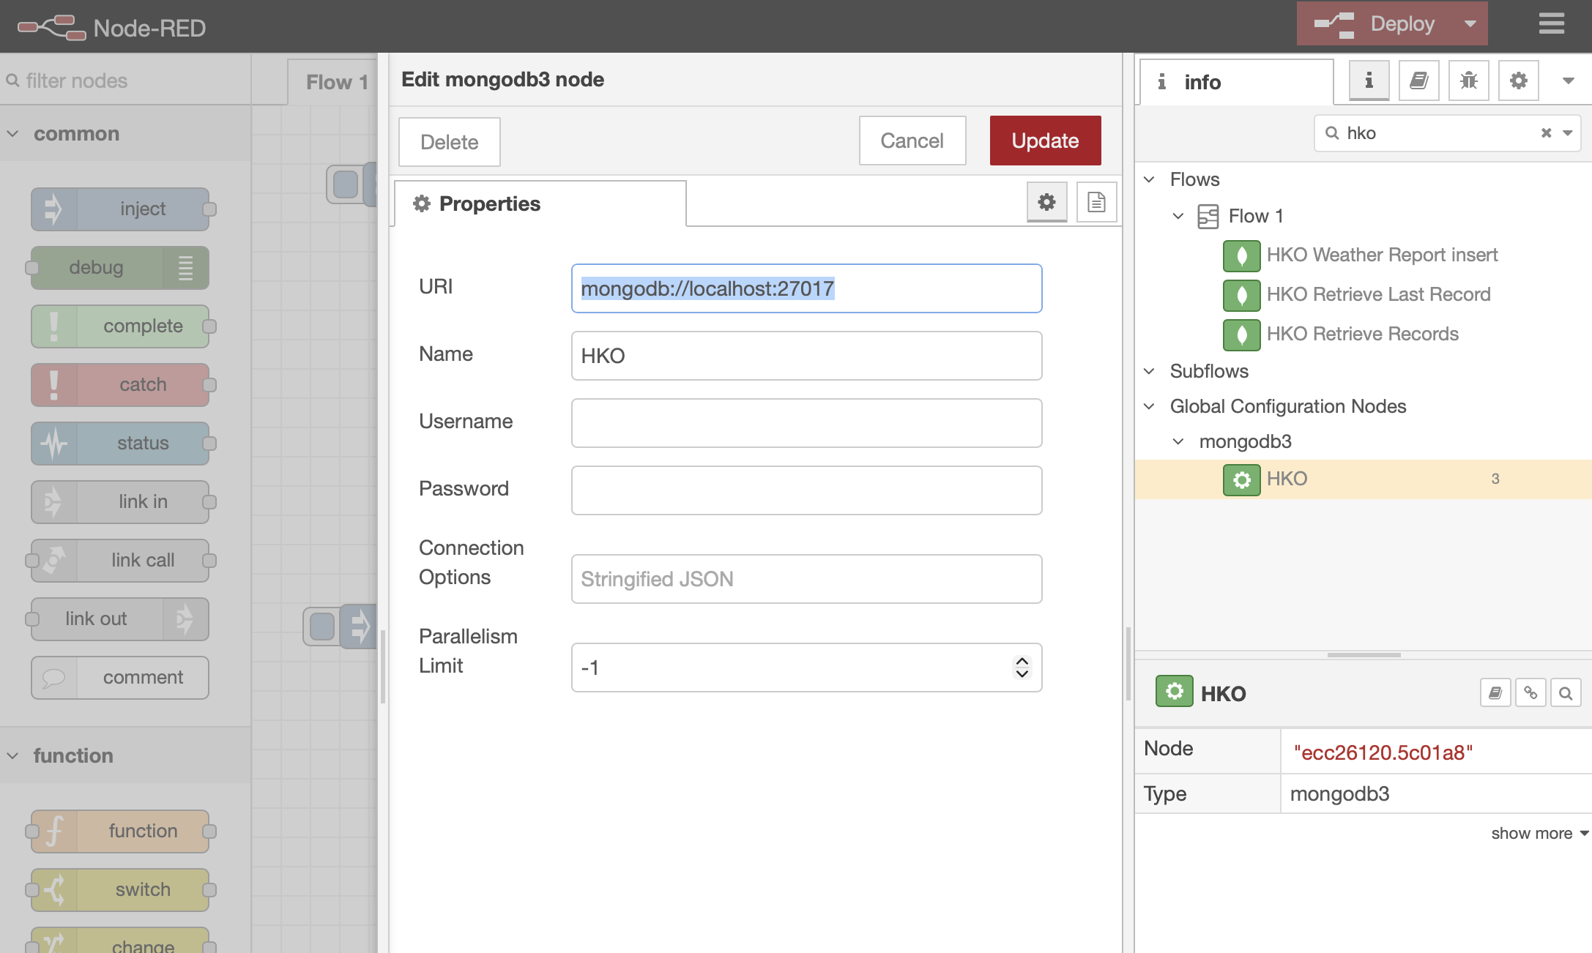
Backup (for Mac users)
Change this URL to mongodb://host.docker.internal:27017/test if the data is empty in visualizer

Slide 40
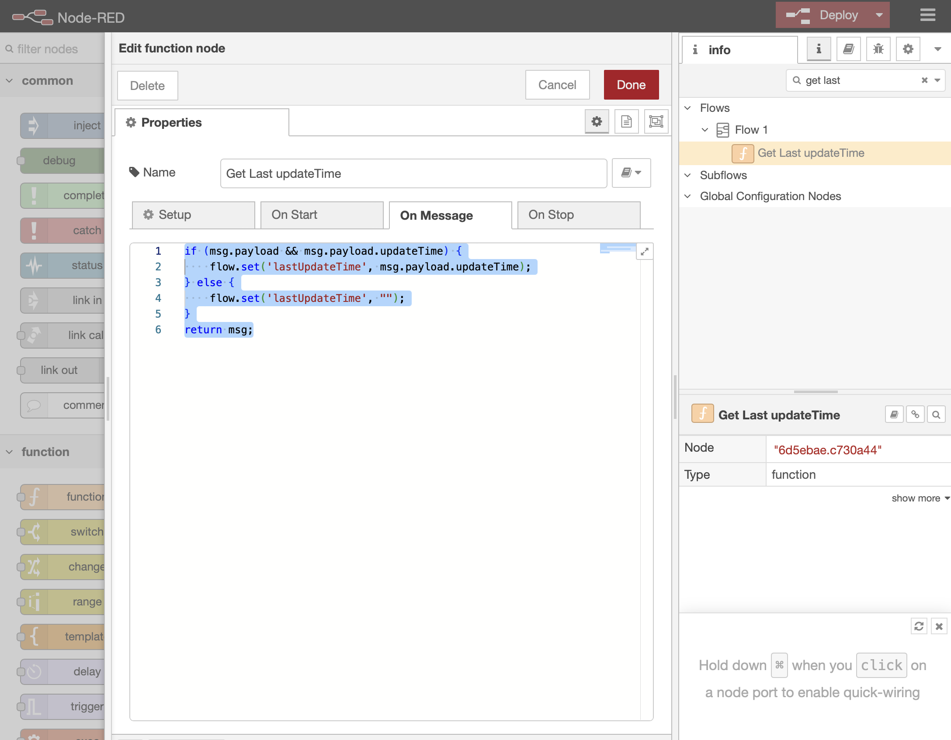
Backup (for Mac users)
If still does not work: change “get last update time” to
if (msg.payload && msg.payload.updateTime) {
flow.set('lastUpdateTime', msg.payload.updateTime);
} else {
flow.set('lastUpdateTime', "");
}
return msg;

